Slide 1
Tuesday, February 16
Core 1 ONLY
Grab a warm-up from the front table and complete Monday’s Warm-up.
Turn in any growth slips, permission forms, or interims to the work slot!

Slide 2
To Do List
Core 1 ONLY
HOWL University
Review Quiz…ask/answer any questions.
Review Independent & Dependent Variables
Lesson: Tables and the Coordinate Plane
Biogen Lunch Survey

Slide 3
Julie runs a marathon…
Core 1 ONLY
A WHAT…?!
She cray!
For every yard she runs she burns six calories.
Identify the independent variable.
Now what is the dependent variable?
Could you figure out how many calories she burned by running 80 yards?
What about in a whole marathon? (1 marathon = 46,145 yards)
What could you create to log or find this information?

Slide 4
Homework 2/16
Core 1 ONLY
Signed Permission Slips
Signed Growth Slips
Signed Interims
**Complete the Graphing Equations HW Worksheet! **

Slide 5
Wednesday, February 17th
Core 1 ONLY
Grab a warm-up from the front table and complete Wednesday’s Warm-up.
Turn in any growth slips, permission forms, or interims to the work slot!

Slide 6
To Do List
Core 1 ONLY
Check HW using Desmos Graphing Calculator (See me for specific questions!)
Practice: Graphing Equations and Tables (**back of HW**)
Review & Answer questions as a class

Slide 7
Homework 2/17
Core 1 ONLY
**Tenmarks Assignment DUE TOMORROW!**
**Fill out Biogen Field Trip LUNCH SLIP! **
Signed Permission Slips
Signed Growth Slips
Signed Interims

Slide 8
Thursday, February 18th
Core 1 ONLY
Grab a warm-up from the front table and complete Thursday’s Warm-up.
Turn in any growth slips, permission forms, or interims to the work slot!
Give Mrs. Phillips your BIOGEN LUNCH SLIPS!!

Slide 9
To Do List
Core 1 ONLY
Check HW/Ask questions! (10 min)
Lesson: Constant of Proportionality
Direct Instruction (10 min)
Guided/Independent Practice (20)
Review & Answer questions as a class (10 min)

Slide 10
Are they Proportional?
**If both values show
the same relationship/pattern, they
ARE PROPORTIONAL! **
Core 1 ONLY
How would I be able to tell if a graph is proportional by looking at the table?
Yards (x) | Calories (y)
0 | 0
1 | 6
2 | 12
3 | 18
4 | 24
Does the relationship between the x-values match the relationship between the y-values?
1 · 2 = 2
6 · 2 = 12

Slide 11
YOUR TASK
Core 1 ONLY
Complete the “Are They Proportional” Activity Provided. Use the graphs found on my curriculum calendar at my website. (www.phillips6thccmms.weebly.com)
Ask any questions regarding this worksheet or any content so far!! NOW IS THE TIME TO ASK QUESTIONS!!
Early Finisher?
Task Cards! (found at the window seal)
Work individually or in pairs.

Slide 12
Homework 2/18
Core 1 ONLY
**Unit 10 TEST Tuesday, Feb. 23rd**
**Fill out Biogen Field Trip LUNCH SLIP! **
Signed Permission Slips
Signed Growth Slips
Signed Interims

Slide 13
Friday, February 19th
Core 1 ONLY
Grab a warm-up from the front table and complete Friday’s Warm-up. TURN IT IN
Turn in any growth slips, permission forms, or interims to the work slot!
Give Mrs. Phillips your BIOGEN LUNCH SLIPS!!

Slide 14
To Do List
Core 1 ONLY
Check HW/Ask questions! (10 min)
Lesson: Constant of Proportionality
Direct Instruction (10 min)
Guided/Independent Practice (20)
Review & Answer questions as a class (10 min)

Slide 15
Constant of Proportionality
You can find the C of P using
tables, graphs, equations,
and ordered pairs!
A.K.A - Unit Rate!

Slide 16
Using a Table!

Slide 17
Using a Graph!

Slide 18
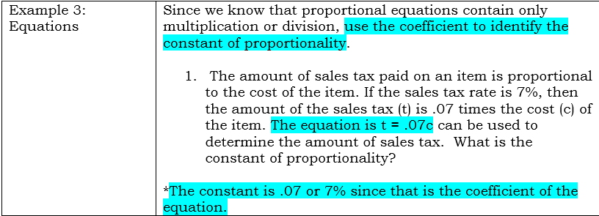
Using a Equation!

Slide 19
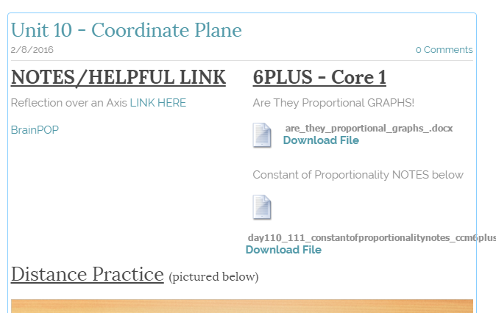
YOUR TASK
Core 1 ONLY
Complete the “Constant of Proportionality” Activity Provided. Use your notes! You can also find a copy on my website. (www.phillips6thccmms.weebly.com)
Ask any questions regarding this worksheet or any content so far!! NOW IS THE TIME TO ASK QUESTIONS!!
Early Finisher?
Task Cards!
(found at the window seal)
Work individually or in pairs.

Slide 20
Homework 2/19
Core 1 ONLY
**Unit 10 TEST Tuesday, Feb. 23rd**
**CAUSES**
**Fill out Biogen Field Trip LUNCH SLIP! **
Signed Permission Slips
Signed Growth Slips
Signed Interims

