Slide 1
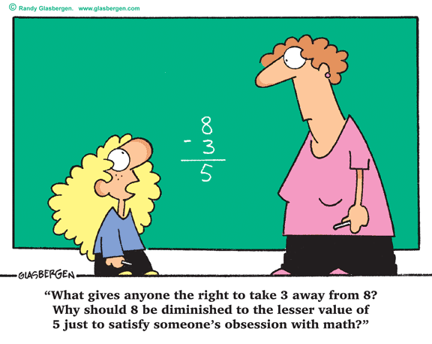
Numerical Data
Standards: 6.SP.1 6.SP.2 6.SP.4 6.SP.5a 6.SP.5b
Uses data and statistical measures for a variety of purposes

Slide 2
Essential Question: How can you summarize and display numerical data?
Statistics
…is the process of collecting, organizing, and interpreting data.
…is used to plan and make future decisions and to answer statistical questions.

Slide 3
What are statistical question?
They are questions that have many different, or variable, answers. **You expect to get a variety of answers.
Which of the following questions is a statistical question?
Only one answer.
How tall is the town’s mayor?
What are the heights of the players on the school basketball team?
You expect to get many answers

Slide 4
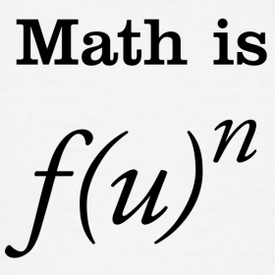
On your paper, make two headings. One side label Statistical Questions and the other side label Non-Statistical Question. As the questions are shown, place them under the correct heading.
1. What is Mike’s shoe size?
Non-Statistical
2. What are the shoe sizes of students my age?
Statistical
3. How tall are my classmates?
Statistical
4. How tall is Joanie?
Non-Statistical
5. How old is Chris’s pet?
Non-Statistical
6. How old are my friends’ pets?
Statistical
7. How far does Terrence drive to work?
Non-Statistical
8. How far do the employees of this store drive to work?
Statistical

Slide 5
Reflect: Choose one of the statistical questions from the list. How might you find the answers to this question? What units might the answer be in?
Example: “How tall are my classmates?”: Measure each classmate or ask classmates their heights; feet and/or inches.
Ways to Collect Data
Questionnaires or surveys
Interviews
Logs or diaries
Census
Observation
Internet Research

Slide 6
With your shoulder partner…Brainstorm a list of statistical questions. Be ready to write your responses on the board.

Slide 7
With a group of three… answer the questions on “Statistical Questions”. Be prepared to share your solutions.
Debrief: Write your answers in your journal.
1. What is a statistical question?
2. How did you decide on the statistical question?

