Slide 1
Equations and Inequalities Part 2: Identifying Solutions to Equations and Inequalities
Essential Question:
How can I determine if given value(s) provide solution(s) to an equation or inequality?

Slide 2
Testing Connection
Which of the following does x = 5 provide a solution?
I 17 = 3x + 2
II x + 9 ≥ 10
III x + 2 < 7
All the above
A and B
A and C
B and C
None of the above
Answer: B

Slide 3
Warm-Up
1. What do these signs mean?
> < ≥ ≤
2. What number(s) can you replace the “x” with?
4 < x 4 > x 4 ≤ x 4 ≥ x

Slide 4
Partner/Group Activity
Decide who goes first.
Write statement a on your group’s whiteboard.
Explain whether or not that particular statement is true or false when w = 1.
Ask your group members if they agree or disagree with you.
Discuss the problem until you all come to an agreement.
Record your decision. Be prepared to share your group’s thoughts with the class.
Give the whiteboard to another group member.
Repeat this process until you are finished with all eight statements.
If w =1 which of the following statements would be true?
a) w + 2 = 3 b) w + 2 > 3 c) w + 2 ≥ 3
d) w + 2 ≤ 3 e) w + 2 < 3 f) w + 2 = 4
g) w + 2 < 4 h) w + 2 > 4

Slide 5
Solutions
If w =1 which of the following statements would be true?
a) w + 2 = 3 b) w + 2 > 3 c) w + 2 ≥ 3
3 = 3 3 > 3 3 ≥ 3
True False True
d) w + 2 ≤ 3 e) w + 2 < 3 f) w + 2 = 4
3 ≤ 3 3 < 3 3 = 4
True False False
g) w + 2 < 4 h) w + 2 > 4
3 < 4 3 > 4
True False

Slide 6
Solutions to Equations and Inequalities Notes
Solution – the value or values that make an equation or inequality true
Is m = 4 a solution to 5m + 10 > 7m – 2?
To determine if a given value is a solution:
Substitute the given value into the equation or inequality
Simplify the expression on either side of the equation or inequality (note: the >, <, ≤, ≥ and = separates the two sides)
Determine if the simplified expressions satisfy the equal or inequality symbol
5m + 10 > 7m – 2 is m = 4 a solution?
5(4) + 10 > 7(4) – 2
20 + 10 > 28 – 2
30 > 26
Yes 30 is greater than 26, this statement is true!

Slide 7
You Try
Is x = 2 a solution to the following equations and inequalities?
1. 3 + x = 5 2. 3 + x > 0
3. 3 + x ≥ 5 4. 3 + x > 5
5. 2 = 3x -4 6. 2x – 1 = 2
7. 6 + x < 8 ÷ x 8. 6 + x > 8 ÷ x
9. 6 - x = 8 ÷ x 10. 6 + x = 8 ÷ x

Slide 8
Solutions
1. 3 + x = 5 2. 3 + x > 0
Yes Yes
3. 3 + x ≥ 5 4. 3 + x > 5
Yes No
5. 2 = 3x -4 6. 2x – 1 = 2
Yes No
7. 6 + x < 8 ÷ x 8. 6 + x > 8 ÷ x
No Yes
9. 6 - x = 8 ÷ x 10. 6 + x = 8 ÷ x
Yes No

Slide 9
Independent Practice
Holt Course 1 – Lesson 2-3
Identifying Solutions to Equations and Inequalities- Worksheet Practice A
Identifying Solutions to Equations and Inequalities – Worksheet Practice B
Challenge

Slide 10
Challenge
Write your own!
Write 3 or 4 equations or inequalities
Give a set of possible solutions
Have a partner determine which values provide solutions to your equations or inequalities!

Slide 11
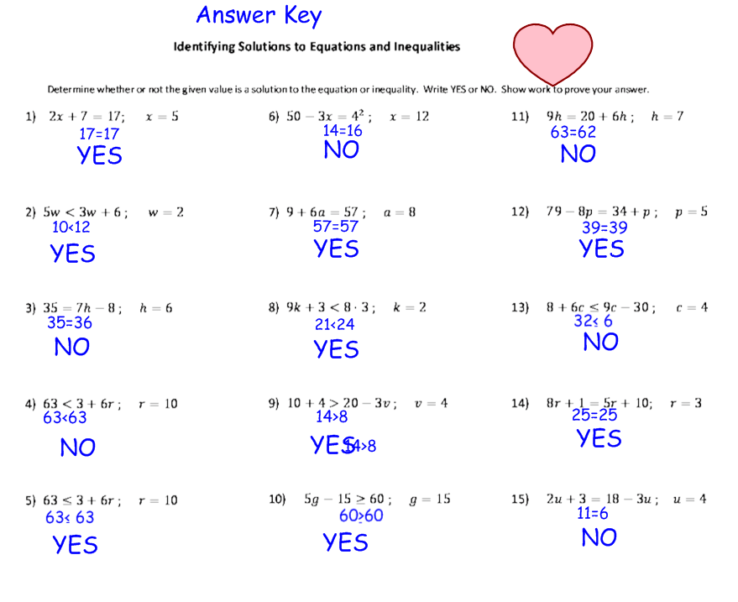
Identifying Solutions to Equations and Inequalities- Worksheet Practice A Solutions

Slide 12
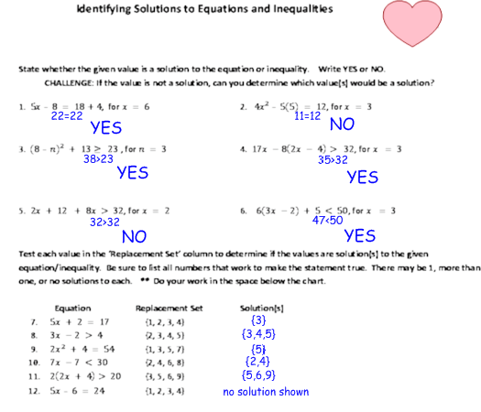
Identifying Solutions to Equations and Inequalities – Worksheet Practice B Solutions

Slide 13
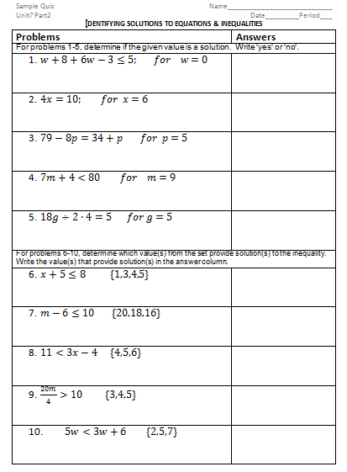
Part 2 Quiz

Slide 14
Reteaching
Solutions to Equations and Inequalities Video - https://www.youtube.com/watch?v=0EMUtIV13H8&feature=share&list=PLNDkuWRw1gGTgaYk6dQhGp10UT41lPFTM
Holt 2-3 Reteaching
Gallery Walk

Slide 15
Enrichment
Problem Solving Challenge
Holt 2-3 Practice C

