Slide 1
Part 2: Solutions to Equations & Inequalities REVIEW
Scale Gallery Walk

Slide 2
Equations and Inequalities Part 3: Modeling & Solving One-Step Equations
I CAN… identify strategies I can use to determine the solution to a one-step equation.

Slide 3
Think about it!
Instead of determining if a given value is a solution, how might you actually find the solution to an equation?
What is the value of x?
x + 2 = 10 5x = 30 10 –x = 7
What about this one? Take a guess!
2x + 5 + 7x – 2 – 3 = 100 ÷ 2 + 13

Slide 4
Equations
Some equations are easy to solve in our heads.
6 = a + 4 m – 5 = 2
x ÷ 2 = 3 10 = g • 5
Using mental math, determine the value of the variable in each equation.
We can use what we know about those easy equations to solve harder ones!

Slide 5
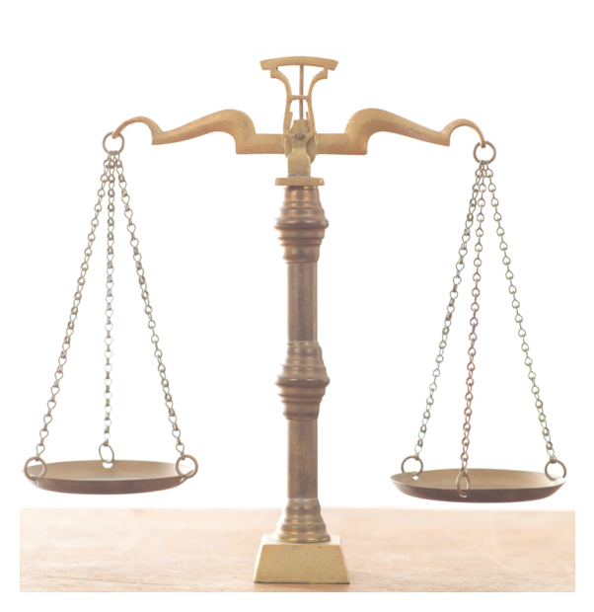
Equations Like a balanced scale
2 • 10 + 7 = x + 3
Think. Pair. Share
What would you do to find the value of x?

Slide 6
Equations Like a balanced scale
Rename 7 with a 3 and 4.
Now you can take away a 3 from both sides to keep the scale balanced.
2 • 10 + 7 = x + 3
Lesson Adapted from Hands on Equations
10
10
7
3
What does the scale now tell you about the weight of the ?

Slide 7
You Try
2x = 5 + 15

Slide 8
You Try
6 •2 + 5 = x + 1

Slide 9
Hands on Equations
Refer to CMAPP for Hands-On lesson examples and student exercises.

Slide 10
Hands on Equations
Classwork Sheets for Lessons 1-7
Additional Exercises
Note: The problem #s listed below correspond with 6th Grade CCSS. Problems omitted include equations with variables on both sides. These problems can be introduced to higher level learners as a method of differentiation.
Lesson 1: #s 1, 2, 3, 5, 6 and 8
Lesson 2: #s 5, 6, 7, and 10
Lesson 3: #s 5 and 6
Lesson 4: #5
Lesson 5: #s 2 and 5
Lesson 6: #s 1 and 5
Lesson 7: #s 1 and 5

Slide 11
Solving Equations
Solve the following equation
x – 11 = 3(4)
Steps:
Simplify each side of the equation (if possible)
x – 11 = 3(4)
x – 11 = 12
Goal: Isolate the variable (remove pieces of the equation to get the variable by itself). Perform inverse operations to remove numbers on the same side as the variable. To keep the equation balanced, whatever you did to one side of the equal sign, you must do to the other side.
x – 11 = 12
+11 +11
x = 23
Check your solution by substituting your answer into the original equation.
x – 11 = 3(4)
23 – 11 = 3(4)
12 = 12 Correct Solution!

Slide 12

Additional Examples: Don’t forget to check your solution!
64 = a + 7
12 ÷ 3 = z – 6
m + 15 = 3 + 20
5h = 17 + 2² – 2(3)
2k + 4K = 30
99 – 43 = 10w – 3w
$\frac{z}{8}=2+4$
$11=\frac{y}{3}$

Slide 13
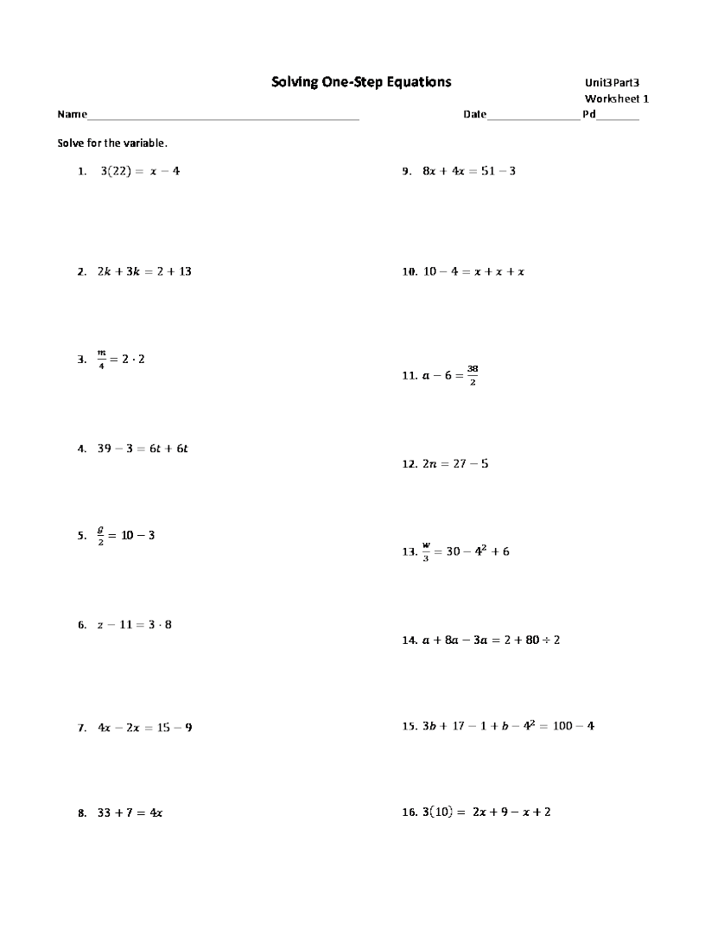

Slide 14
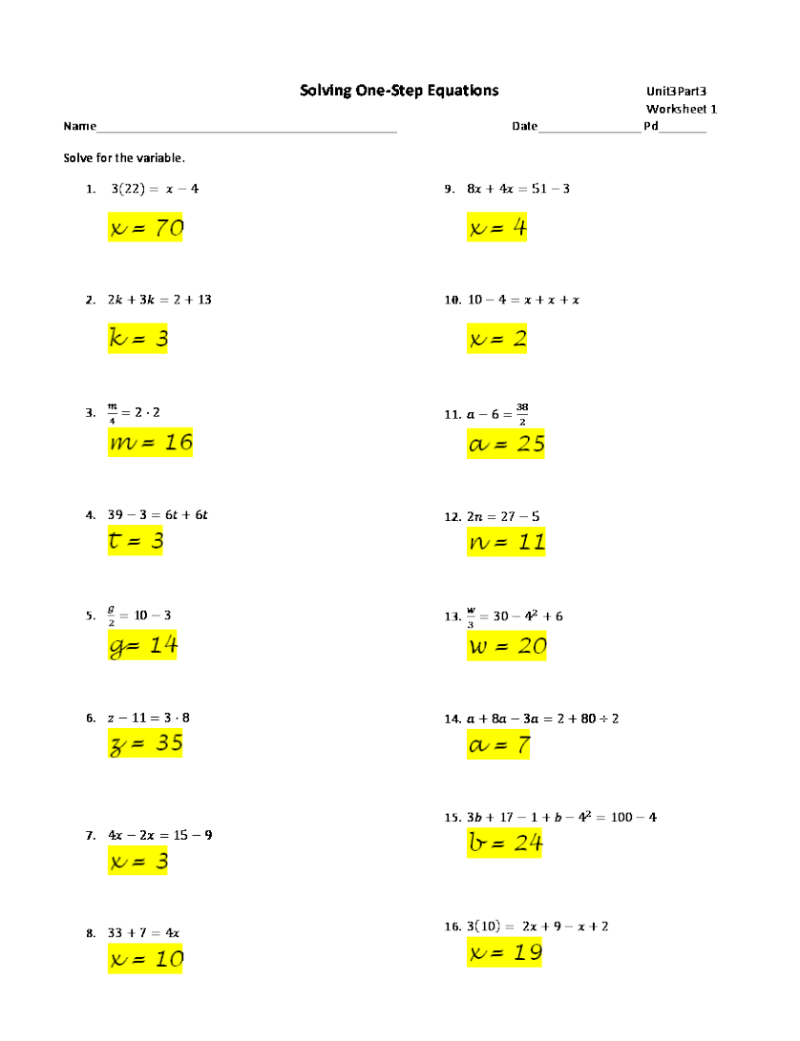

Slide 15
Testing Connection
The goal of solving an algebraic equation is to:
Use inverse operations
Check your solution
Isolate the variable
Do the same thing to both sides of an equation
Answer: C

Slide 16
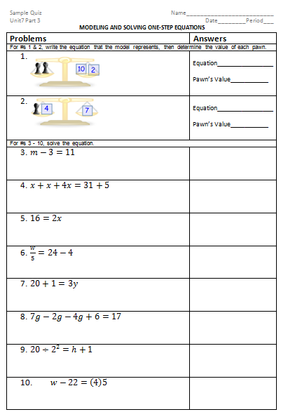

Slide 17
Practice & Other Resources
Holt Course 1
Chapter 2 Resource Book or Online Textbook
Lessons 2-4, 2-5, 2-6, 2-7 – Practice A, B and C
http://www.math-play.com/math-basketball-one-step-equations/math-basketball-one-step-equations.html
http://nlvm.usu.edu/en/nav/frames_asid_201_g_3_t_2.html?open=instructions&from=grade_g_3.html (note this website might contain equations with variables on both sides that is not part of the 6th grade CCSS, but can be used as enrichment for advanced learners)

