Slide 1
GCF and LCM

Slide 2
Greatest Common Factor
The Greatest Common Factor or (GCF) is the highest number that divides evenly into two or more numbers.
When you find the GCF of two numbers, you are finding the biggest number that will divide into both of those numbers.
We are going to look at two methods of finding the GCF.

Slide 3
Method 1 for finding GCF
List all factors for each number then circle the greatest match.
Let’s do an example and find the GCF of 18 and 24.

Slide 4
First we list out all the factors of both numbers.
Then we circle the greatest match.
18:
1,
2,
3,
6,
9,
18
24:
1,
2,
3,
4,
6,
8,
12,
24
The Greatest Common Factor (GCF) of 18 and 24 is 6.

Slide 5
Method 2 for finding GCF
Use Factor Trees to find the Prime Factorization of both numbers.
Enter the numbers from the Prime Factorization into a Venn Diagram, putting the common numbers in the middle.
Multiply the numbers in the middle to get the GCF.
Now let’s try this method to find the GCF of 18 and 24

Slide 6
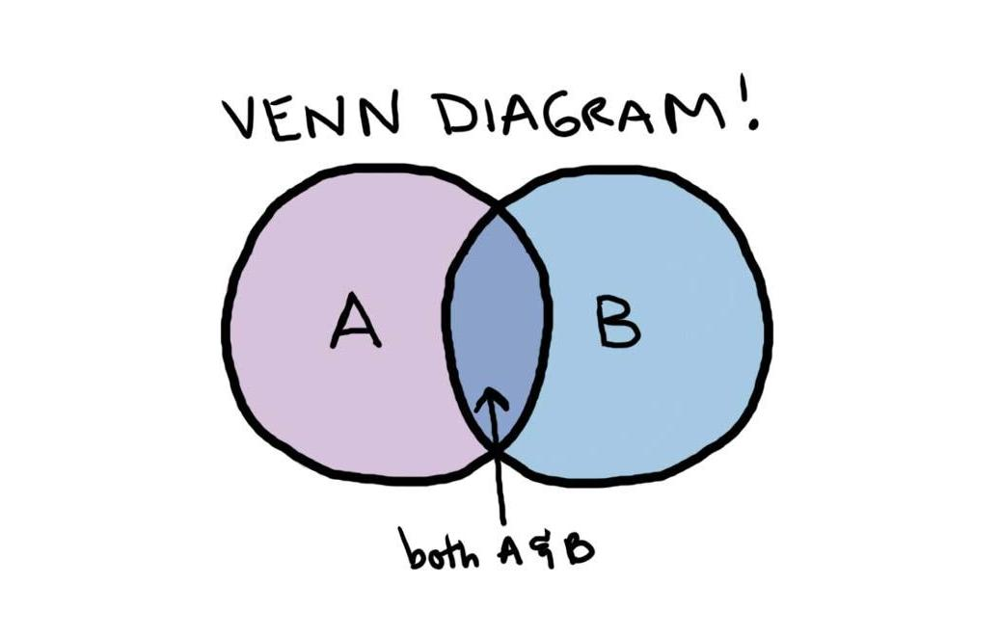
Let’s review Venn Diagrams

Slide 7
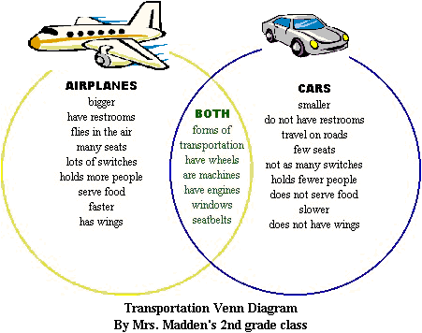
Let’s review Venn Diagrams

Slide 8
First, make a factor tree for each number to find the Prime Factorization.
18
9
2
3
3
Prime Factorization: 2⋅3⋅3

Slide 9
First, make a factor tree for each number to find the Prime Factorization.
24
8
3
4
2
2
2
Prime Factorization: 2⋅2⋅2⋅3

Slide 10
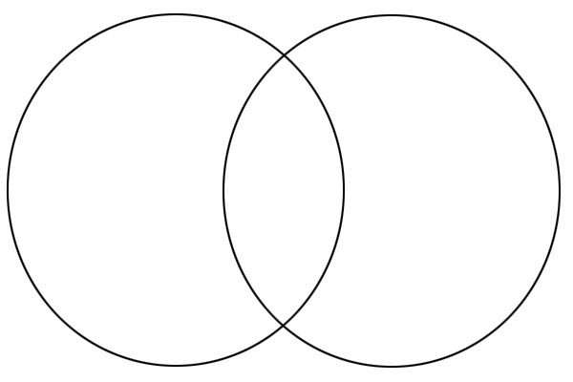
Next, we enter the numbers from the Prime Factorization into a Venn Diagram, putting the common numbers in the middle.
18
24
2
2
3
3
2
2
3
3
2⋅
2
⋅
2
⋅
⋅
⋅3

Slide 11
Finally, we multiply the middle numbers to get the GCF.
18
24
2
2
3
3
2
⋅
= 6
So the GCF of 18 and 24 is 6.

Slide 12
Least Common Multiple
The Least Common Multiple or (LCM) is smallest number that is a multiple of two or more numbers.
When you find the LCM of two numbers, you are finding the smallest number that both numbers will go into.
We are going to look at two methods of finding the LCM.

Slide 13
Method 1 for finding LCM
List multiples for each number 5 at a time. Then circle the smallest match.
Let’s do an example and find the LCM of 12 and 30.

Slide 14
Then we circle the smallest match.
First we list out the first 5 multiples of both numbers.
12:
12,
24,
36,
48,
60
30:
30,
60,
90,
120,
160,
The Lowest Common Multiple (LCM) of 12 and 30 is 60.

Slide 15
Method 2 for finding LCM
Use Factor Trees to find the Prime Factorization of both numbers.
Enter the numbers from the Prime Factorization into a Venn Diagram, putting the common numbers in the middle.
Multiply all of the numbers in the diagram to get the LCM.
Now let’s try this method to find the GCF of 12 and 30

Slide 16
First, make a factor tree for each number to find the Prime Factorization.
12
4
3
2
2
Prime Factorization: 2⋅2⋅3

Slide 17
First, make a factor tree for each number to find the Prime Factorization.
30
10
3
2
5
Prime Factorization: 2⋅3⋅5

Slide 18
Next, we enter the numbers from the Prime Factorization into a Venn Diagram, putting the common numbers in the middle.
12
30
2
2
3
5
2
2
2⋅
3
⋅
5
⋅
⋅
3

Slide 19
Finally, we multiply all of the numbers to get the LCM.
12
30
2
5
2
3
So the LCM of 12 and 30 is 60
⋅ ⋅ ⋅
= 60

Slide 20
Remember not to get the GCF and LCM mixed up.
When finding the GCF, you are looking for a number that is smaller than the two given numbers
When finding the LCM, you are looking for a number that is larger than the two given numbers

