Slide 1
6th Grade Math
With Mrs. Phillips!

Slide 3
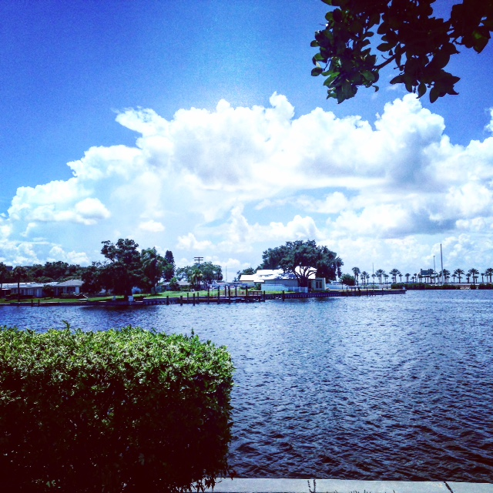
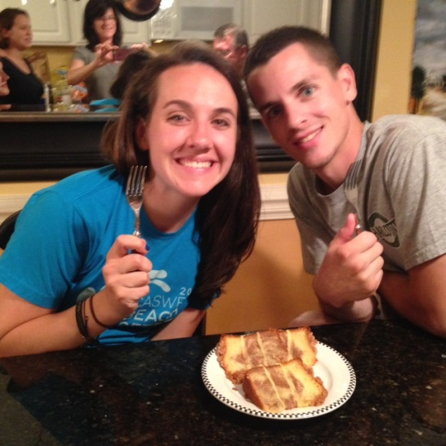
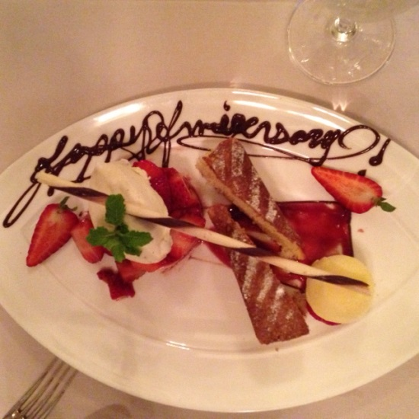
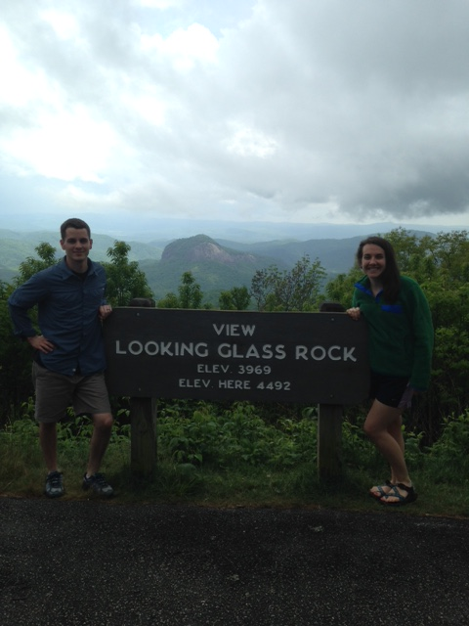
Over the summer I…
Went to Charleston, SC with family!
Went to Tampa, FL!
Celebrated my first wedding anniversary with my Husband!
Went to backpacking w/ family!

Slide 4
*How would you define these? *Can you give an example of each being properly displayed in the classroom?
Honor
Order
Wisdom
Leadership

Slide 5
Important Information
Email: cphillips2@wcpss.net
Class Website: http://phillips6thccmms.weebly.com
Twitter: @MrsPhillips6th
School Website: http://www.wcpss.net/centennialms

Slide 6
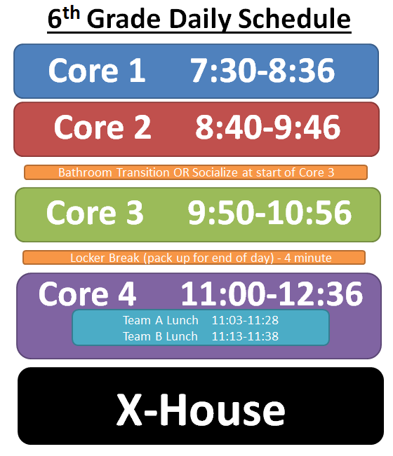

Slide 7
A typical week in Mrs. Phillips’ Math class…
**Quizzes will not always be announced. However, you can expect an online quiz each Friday on the content covered that week.
**Students will be notified of a Test at least 2-3 days in advance.
Monday- Direct Instruction & Guided Practice
Tuesday- Direct Instruction & Guide Practice
Wednesday- Stations & Collaborative Learning
Thursday- Stations & Collaborative Learning
Friday- Assessments, Practice, (& sometimes games) ☺
Will you be expected to complete homework every night…?
YES! It must be recorded in your agenda every day and signed by the teacher.
Can anybody guess what the acronym MSW stands for?
Must Show Work – You’re work must be shown all the time!

Slide 8
Math Stations Wednesday’s & Thursday’s
Comprehension (Teacher Group)- This station can include the following: mini-assessments, checklists, student conferences, review, or remediation.
Application- This is the station that will allow you to practice and apply the skills that are being taught that week.
Fluency- This station allows you to master the skill of the week (or maybe previous skills) so that you are fluent in it/them.
Enrichment- This station takes what you have already learned to a new level and will challenge you to think ahead or outside of your natural realm of thinking.
**At the end of each week these activities will be collected, along with your CAFÉ stations contract for a classwork grade**

Slide 9
What to look forward to in Mrs. Phillips class…
Computers!
Games!
Collaborative Learning!
Music!
Food…candy….?!
Laughter!
Hands on Math Application!
Seeing how much you will GROW in your understanding & application of math concepts!

Slide 10
Grading Policy
30% Formative assessments (the assessment of knowledge gained during the learning process) include:
warm ups, class work, practice work, homework, exit slips, quizzes, vocabulary
70% Summative assessments (the assessment of knowledge gained at the end of the learning process) include:
essays, quizzes, tests, labs, projects
Letter Grades:
A = 90 - 100
B = 80-89
C = 70-79
D = 60 - 69
F = <60

Slide 11
Missing & Makeup Work Policy
It is the student’s responsibility to request and submit make-up work upon returning to school.
If the teacher assigns work in advance, including tests and projects, it is due the day the student returns to school.
If the makeup work is not assigned in advance, for absences of 1-3 days, the student has one day for each day absent to make up the work. If the student is absent for more than three days, the student has two days for each day absent.
The student is responsible for securing make-up work at the secondary level per WCPSS policy.
Assignments submitted late due to absence must include an attached late slip to be considered for full credit.
*If you would like to know any other information regarding your grade, missing assignment, or makeup work see me:
-During morning Homeroom time
-By appointment

Slide 12
Late Work Policy
Assignments not submitted including class work, practice work, homework earn a score of “50”.
Late work is the result of a student being present in school but not submitting the work by the designated time, such as at the start of class when being collected.
Students should submit an assignment using a “Late Slip” filled out in order for the assignment to be graded. This assignment will be accepted up to a week from its due date.
Assignments submitted without a proper heading are placed in the recycle bin as if they were not turned in.
A proper heading should include:
Name:______________
Date:_______________
Period:______________

Slide 13
Late Work Submission Procedures
Assignments not submitted on time earn a score of “50”.
Students submitting late work prior to the next assessment (end of the unit) with a late slip:
The late slip should include or could lead to:
Explains why the work should be accepted
Explain how to solve the late work issue
Obtain Parent/Guardian Signature
May need to attend a conference

Slide 14
Expectations for Entering the Classroom
Quietly.
By sitting in your assigned seat.
With pencils sharpened and materials ready.
By reading the board/projector screen for you’re warm-up activity/assignment.
During the warm-up you may prepare materials (ex. Sharpen pencils, etc) without permission.

Slide 15
Expectations in the Classroom
Do not talk while the teacher is talking.
Raise you’re hand to speak.
Stay in the classroom unless you have been given permission to leave (note/hall pass required).
Do not get out of your seat without being told to…with the exception of blowing your nose or sharpening your pencil.
Adhere to the attention signals!! When the signal is given no one should be talking & everyone’s eyes should be looking at the teacher.
Keep your hands to yourself & do not touch things that do not belong to you unless you have been given permission.
Whatever I write on the board or document camera needs to be written by you in your notes unless told otherwise.
Handle classroom materials with care. This includes returning them to the proper location.

Slide 16
Morning Expectations (Homeroom only)
1. Enter the building (go to breakfast if needed, this should be done before unpacking).
2. Use the restroom & unpack.
3. Go to your 1st core (homeroom)
4. Enter the classroom quietly and have a seat.
5. Proactively & quietly use this time!
*Once you have entered the room, you cannot exit!*
During this time, potential activities may be:
Monday’s- make 1 personal & 1 academic goal for the week
Focus on Covey habit of the week.
Read
Ask Mrs. Phillips any questions you might have about math content, grades, missing assignments, makeup work, etc.
Work on makeup work or missing assignments.

Slide 17
Hallway Expectations
You MUST have a note or hall pass (agenda page) when in the hallways without your class!!
If you need a note, fill out the front of your agenda or create a note by writing:
Your Name
Desired Destination
Date
Times
& get it signed by the teacher!
When walking in the hallways with your class you are to be walking on the right side of the hallway and quietly.
Attention signals still apply in this area! In Fact: they apply everywhere!
You must not be in the Den at anytime unless given teacher permission!

Slide 18
Procedure for Tardy Students
*This procedure applies to all class periods. Not just homeroom.*
Enter the room without disturbing class.
Sign in on the computer next to the door. Follow the questions/instructions on the computer.
Leave your note in the basket next to the computer.
Have a seat quietly & raise your hand for any questions regarding what you missed.
**If you’re tardy is unexcused or you do not have a note, you are STILL REQUIRED to sign in on the laptop.**

Slide 19
Agendas
You will be required to write your homework in your agenda & have it signed by me everyday before leaving class.
One of the front pages in your agenda serves as a hall pass page where you can easily be permitted (w/ a teacher signature) into the hallway.
Your agenda also has other pages with helpful formulas, a 10x10 grid, and other resources you might need!

Slide 20
Cafeteria Expectations
In the cafeteria you are to sit with your Core 4 class in your team’s designated area!
When entering you must have a seat before lining up for lunch. Your teacher will dismiss you to line up!
The seat you choose when you enter, is the seat you keep until lunch is over for that day. Please return to that seat once you have gone through the lunch line.
Please raise your hand if you need to get out of your seat. (Make eye contact with an adult so you know they see your hand up!)

Slide 21
Fire Drills & Alarms
When the fire alarm goes off our class should QUIETLY and CALMLY walk out the front entrance of the school!

Slide 22
WOAH!
I know that this is A LOT of information. All of these things will continue to be reviewed and discussed as the year continues.
All of these things also coincide/adhere to the Team Procedures sheet that both Parent/Guardian & Student should have signed.
If you have any questions feel free to email me. This Power Point will stay on my website to refer to at any time.

